Slide 1
Kafka

Slide 2
Apache Kafka is a distributed publish-subscribe messaging system
that lets us:
1. Publish and subscribe to streams of records.
2. Store streams of records in a fault-tolerant way.
3. Process streams of records as they occur
Kafka runs as a cluster on one or more servers.
The Kafka cluster stores a stream of records in categories called topics.
Each record consists of a key, a value, and a timestamp.
that is designed to be fast, scalable, and durable. It is an open-source stream processing platform. Apache Kafka originated at LinkedIn and later became an open-source Apache project in 2011, then a first-class Apache project in 2012. Kafka is written in Scala and Java. It aims at providing a high-throughput, low-latency platform for handling real-time data feeds.
Kafka is suitable for both offline and online message consumption. Kafka messages are persisted on the disk and replicated within the cluster to prevent data loss. Kafka is built on top of the ZooKeeper synchronization service. It integrates very well with Apache Storm and Spark for real-time streaming data analysis.

Slide 3
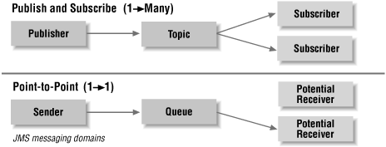
What is a Messaging System?
A Messaging System is responsible for transferring data from one application to another, so the applications can focus on data, but not worry about how to share it. Distributed messaging is based on the concept of reliable message queuing. Messages are queued asynchronously between client applications and messaging system. Two types of messaging patterns are available − one is point to point and the other is publish-subscribe (pub-sub) messaging system. Most of the messaging patterns follow pub-sub.

Slide 4
Point to Point Messaging System
In a point-to-point system, messages are persisted in a queue. One or more consumers can consume the messages in the queue, but a particular message can be consumed by a maximum of one consumer only. Once a consumer reads a message in the queue, it disappears from that queue. The typical example of this system is an Order Processing System, where each order will be processed by one Order Processor, but Multiple Order Processors can work as well at the same time. The following diagram depicts the structure.
Publish-Subscribe Messaging System
In the publish-subscribe system, messages are persisted in a topic. Unlike point-to-point system, consumers can subscribe to one or more topic and consume all the messages in that topic. In the Publish-Subscribe system, message producers are called publishers and message consumers are called subscribers. A real-life example is Dish TV, which publishes different channels like sports, movies, music, etc., and anyone can subscribe to their own set of channels and get them whenever their subscribed channels are available.

Slide 5
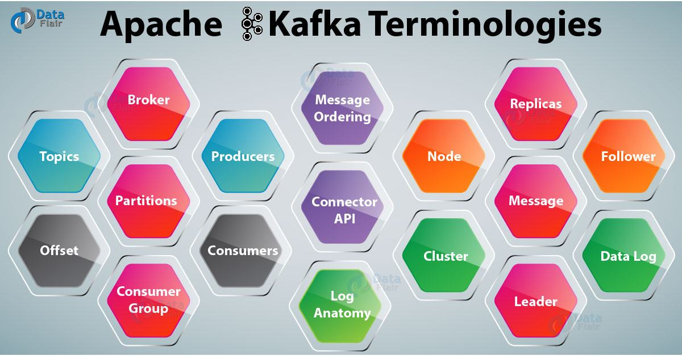

Slide 6
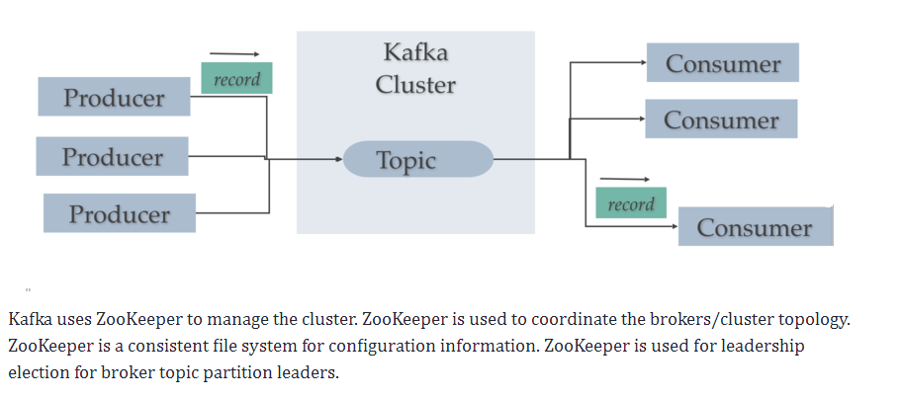
Kafka consists of records, topics, consumers, producers, brokers, logs, partitions, and clusters.
Records can have keys (optional), values, and timestamps. Kafka records are immutable.
Topic:-
A Kafka Topic is a stream of records .
The Kafka cluster stores a stream of records in categories called topics.
. Kafka messages are generally organized into Kafka topics
.

Slide 7
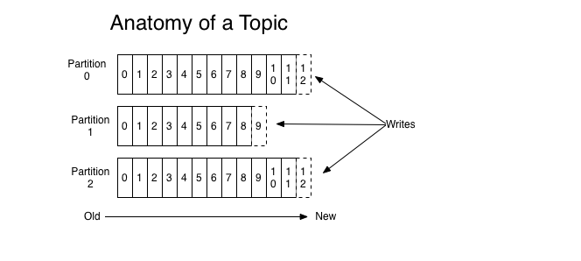
A topic is a feed name or category to which records are published. Topics in Kafka are always multi-subscriber — that is, a topic can have zero, one, or many consumers that subscribe to the data written to it. For each topic, the Kafka cluster maintains a partition log that looks like this:
A topic has a log which is the topic’s storage on disk. A topic log is broken up into partitions and segments
Moreover, here messages are structured or organized. A particular type of messages is published on a particular topic.
Basically, at first, a producer writes its messages to the topics. Then consumers read those messages from topics.
In a Kafka cluster, a topic is identified by its name and must be unique.
There can be any number of topics, there is no limitation.
We can not change or update data, as soon as it gets published.

Slide 8
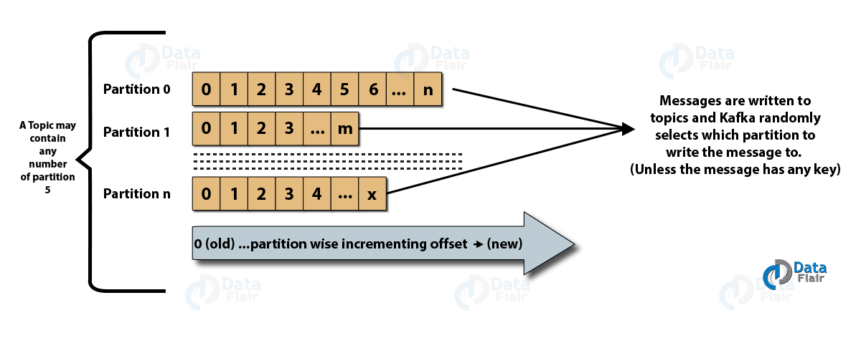
Partitions
A topic may have many partitions so that it can handle an arbitrary amount of data. In the above diagram, the topic is configured into three partitions (partition{0,1,2}). Partition0 has 13 offsets, Partition1 has 10 offsets, and Partition2 has 13 offsets.

Slide 9
These Kafka partitions in Kafka can be both a leader or a replica of a topic. So, on defining a Leader, it is responsible for all writes and reads to a topic whereas if somehow the leader fails, replica takes over as the new leader.
Partition Offset
Each partitioned message has a unique sequence ID called an offset. For example, in Partition1, the offset is marked from 0 to 9.
The position of the consumer in the log and which is retained on a per-consumer basis is what we call Offset. Moreover, we can say it is the only metadata retained on a per-consumer basis.
Kafka Producer Send, Acks and Buffers ****
The Kafka Producer has a send() method which is asynchronous. Calling the send method adds the record to the output buffer and return right away. The buffer is used to batch records for efficient IO and compression. The Kafka Producer configures acks to control record durability. The ”all” acks setting ensures full commit of record to all replicas and is most durable and least fast setting. The Kafka Producer can automatically retry failed requests. The Producer has buffers of unsent records per topic partition (sized at batch.size).

Slide 10
A Kafka Producer has a pool of buffer that holds to-be-sent records
The buffer is used to batch records for efficient IO and compression.
Kafka Producer: Buffering and batching
The Kafka Producer buffers are available to send immediately. The buffers are sent as fast as broker can keep up (limited by in-flight max.in.flight.requests.per.connection). To reduce requests count and increase throughput, set linger.ms > 0. This setting forces the Producer to wait up to linger.ms before sending contents of buffer or until batch fills up whichever comes first. Under heavy load linger.ms not met as the buffer fills up before the linger.ms duration completes. Under lighter load, the producer can use to linger to increase broker IO throughput and increase compression. The buffer.memory controls total memory available to a producer for buffering. If records get sent faster than they can be transmitted to Kafka then and this buffer will get exceeded then additional send calls block up to max.block.ms after then Producer throws a TimeoutException.
http://cloudurable.com/blog/kafka-tutorial-kafka-producer-advanced-java-examples/index.html

Slide 11
b. Partitions in Kafka
In a Kafka cluster, Topics are split into Partitions and also replicated across brokers.
However, to which partition a published message will be written, there is no guarantee about that.
Also, we can add a key to a message. Basically, we will get ensured that all these messages (with the same key) will end up in the same partition if a producer publishes a message with a key. Due to this feature, Kafka offers message sequencing guarantee. Though, unless a key is added to it, data is written to partitions randomly.
Moreover, in one partition, messages are stored in the sequenced fashion.
In a partition, each message is assigned an incremental id, also called offset.
However, only within the partition, these offsets are meaningful. Moreover, in a topic, it does not have any value across partitions.
There can be any number of Partitions, there is no limitation.
Replicas
Replicas are nothing but backups of a partition. If the replication factor of the above topic is set to 4, then Kafka will create four identical replicas of each partition and place them in the cluster to make them available for all its operations. Replicas are never used to read or write data. They are used to prevent data loss.

Slide 12
b. Partitions in Kafka
In a Kafka cluster, Topics are split into Partitions and also replicated across brokers.
However, to which partition a published message will be written, there is no guarantee about that.
Also, we can add a key to a message. Basically, we will get ensured that all these messages (with the same key) will end up in the same partition if a producer publishes a message with a key. Due to this feature, Kafka offers message sequencing guarantee. Though, unless a key is added to it, data is written to partitions randomly.
Moreover, in one partition, messages are stored in the sequenced fashion.
In a partition, each message is assigned an incremental id, also called offset.
However, only within the partition, these offsets are meaningful. Moreover, in a topic, it does not have any value across partitions.
There can be any number of Partitions, there is no limitation.

Slide 13
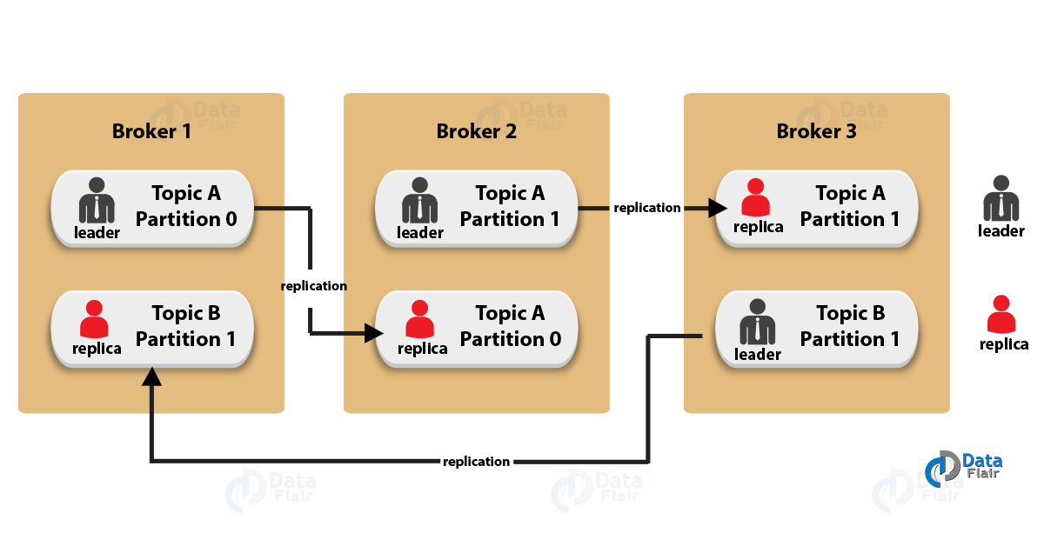
c. Topic Replication Factor in Kafka
While designing a Kafka system, it’s always a wise decision to factor in topic replication. As a result, its topics’ replicas from another broker can solve the crisis, if a broker goes down. For example, we have 3 brokers and 3 topics. Broker1 has Topic 1 and Partition 0, its replica is in Broker2, so on and so forth. It has got a replication factor of 2; it means it will have one additional copy other than the primary one. Below is the image of Topic Replication Factor:

Slide 14
Some key points –
1. Replication takes place in the partition level only.
2. For a given partition, only one broker can be a leader, at a time. Meanwhile, other brokers will have in-sync replica; what we call ISR.
3. It is not possible to have the number of replication factor more than the number of available brokers.
Q7) Elaborate on the terms leader and follower in Kafka environment?
The concept of leader and follower is maintained in Kafka environment so that the overall system ensures load balancing on the servers.
For every partition in Kafka environment, one server plays the role as leader and rest of the servers act as followers.
All the data read and write commands are executed at the leader level and the rest of the followers just have to replicate the process.
At the time of any server faults and the leader is not able to function appropriately then one of the followers will take the place of the leaders. Thus making the system stable and also helps in load balancing of the server.

Slide 15
d. Consumer Group
1. It can have multiple consumer process/instance running.
2. Basically, one consumer group will have one unique group-id.
3. Moreover, exactly one consumer instance reads the data from one partition in one consumer group, at the time of reading.
4. Since, there is more than one consumer group, in that case, one instance from each of these groups can read from one single partition.
5. However, there will be some inactive consumers, if the number of consumers exceeds the number of partitions. Let’s understand it with an example if there are 8 consumers and 6 partitions in a single consumer group, that means there will be 2 inactive consumers.

Slide 16
3. Workflow of Pub-Sub Messaging
In Apache Kafka, the stepwise workflow of the Pub-Sub Messaging is:
1. At regular intervals, Kafka Producers send the message to a topic.
2. Kafka Brokers stores all messages in the partitions configured for that particular topic, ensuring equal distribution of messages between partitions. For example, Kafka will store one message in the first partition and the second message in the second partition if the producer sends two messages and there are two partitions.
Moreover, Kafka Consumer subscribes to a specific topic.
3. Once the consumer subscribes to a topic, Kafka offers the current offset of the topic to the consumer and save the offset in the Zookeeper ensemble.
4. Also, the consumer will request the Kafka in a regular interval, for new messages (like 100 Ms).
5. Kafka will forward the messages to the consumers as soon as received from producers.
6. The consumer will receive the message and process it.
7. Then Kafka broker receives an acknowledgment of the message processed.
8. Further, the offset is changed and updated to the new value as soon as Kafka receives an acknowledgment. Even during server outrages, the consumer can read the next message correctly, because ZooKeeper maintains the offsets.(. ZooKeeper is mainly used to notify producers and consumers about the presence of any new broker in the Kafka system or about the failure of any broker in the Kafka system. ZooKeeper notifies the producer and consumer about the presence or failure of a broker based on which producer and consumer makes a decision and starts coordinating their tasks with some other broker.)

Slide 17
9. However, until the consumer stops the request, the flow repeats.
10. As a benefit, the consumer can rewind/skip any offset of a topic at any time and also can read all the subsequent messages, as a par desire.

Slide 18
4. Workflow of Kafka Queue Messaging/Consumer Group
A group of Kafka consumers having the same Group ID can subscribe to a topic, instead of a single consumer, in a queue messaging system. However, with the same Group ID all consumers, those are subscribing to a topic are considered as a single group and share the messages. This system’s workflow is:
1. In regular intervals, Kafka Producers send the message to a Kafka topic.
As similar to the earlier scenario, here also Kafka stores all messages in the partitions configured for that particular topic.
2. Moreover, a single consumer in Kafka subscribes to a specific topic.
In the same way as Pub-Sub Messaging, Kafka interacts with the consumer until new consumer subscribes to the same topic.
3. As the new customers arrive, share mode starts in the operations and shares the data between two Kafka consumers. Moreover, until the number of Kafka consumers equals the number of partitions configured for that particular topic, the sharing repeats.
4. Although, the new consumer in Kafka will not receive any further message, once the number of Kafka consumers exceeds the number of partitions. It happens until any one of the existing consumer unsubscribes. This scenario arises because in Kafka there is a condition that each Kafka consumer will have a minimum of one partition and if no partition remains blank, then new consumers will have to wait.
5. In addition, we also call it Kafka Consumer Group. Hence, Apache Kafka will offer the best of both the systems in a very simple and efficient manner.

Slide 19
5. Role of ZooKeeper in Apache Kafka
Apache Zookeeper serves as the coordination interface between the Kafka brokers and consumers. Also, we can say it is a distributed configuration and synchronization service. Basically, ZooKeeper cluster shares the information with the Kafka servers. Moreover, Kafka stores basic metadata information in ZooKeeper Kafka, such as topics, brokers, consumer offsets (queue readers) and so on.
In addition, failure of Kafka Zookeeper/broker does not affect the Kafka cluster. It is because the critical information which is stored in the ZooKeeper is replicated across its ensembles. Then Kafka restores the state as ZooKeeper restarts, leading to zero downtime for Kafka. However, Zookeeper also performs leader election between the Kafka brokers, in the cases of leadership failure.

Slide 20
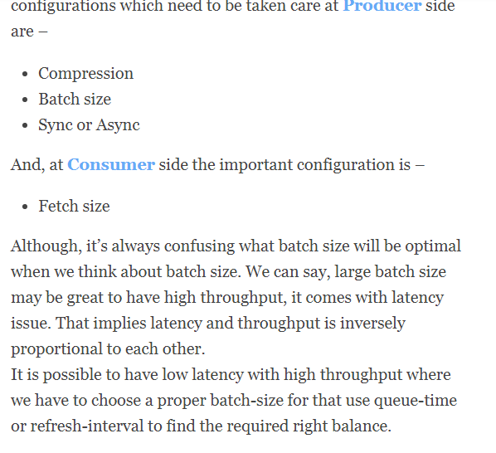
2. What is Kafka Performance Tuning?

Slide 21
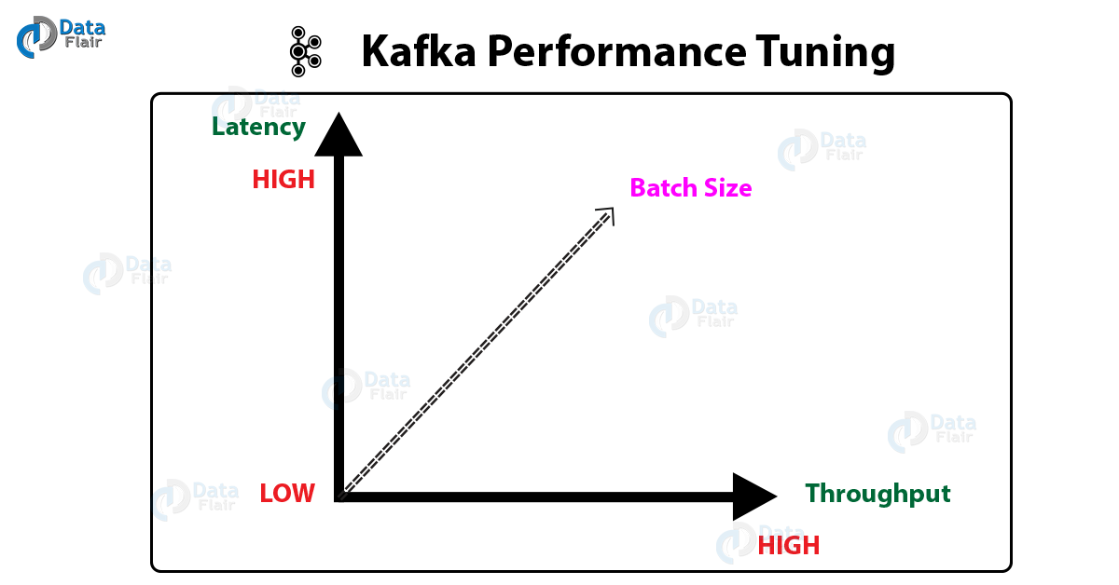

Slide 22
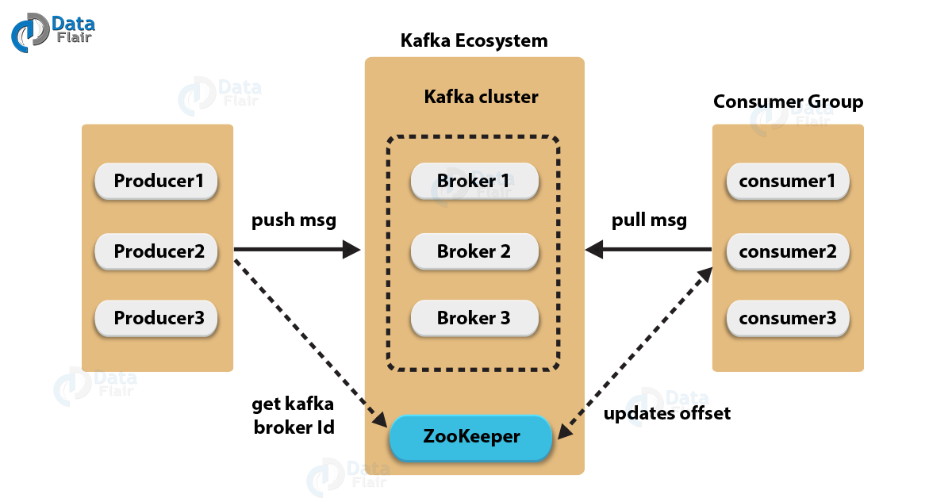

Slide 23
i. Kafka Broker
. A broker is a Kafka server that runs in a Kafka cluster. Kafka brokers form a cluster. The Kafka cluster consists of many Kafka brokers on many servers. Broker sometimes refer to more of a logical system or as Kafka as a whole.
Brokers are simple systems responsible for maintaining published data. Kafka brokers are stateless, so they use ZooKeeper for maintaining their cluster state. Each broker may have zero or more partitions per topic. For example, if there are 10 partitions on a topic and 10 brokers, then each broker will have one partition. But if there are 10 partitions and 15 brokers, then the starting 10 brokers will have one partition each and the remaining five won’t have any partition for that particular topic. However, if partitions are 15 but brokers are 10, then brokers would be sharing one or more partitions among them, leading to unequal load distribution among the brokers. Try to avoid this scenario.
Although, one Kafka Broker instance can handle hundreds of thousands of reads and writes per second. Whereas, without performance impact, each broker can handle TB of messages. In addition, make sure ZooKeeper performs Kafka broker leader election.

Slide 24
ZooKeeper is used for managing and coordinating Kafka brokers. ZooKeeper is mainly used to notify producers and consumers about the presence of any new broker in the Kafka system or about the failure of any broker in the Kafka system. ZooKeeper notifies the producer and consumer about the presence or failure of a broker based on which producer and consumer makes a decision and starts coordinating their tasks with some other broker.
c. Kafka Producers
Further, Producers in Kafka push data to brokers. Also, all the producers search it and automatically sends a message to that new broker, exactly when the new broker starts. However, keep in mind that the Kafka producer sends messages as fast as the broker can handle, it doesn’t wait for acknowledgments from the broker.
d. Kafka Consumers
Basically, by using partition offset the Kafka Consumer maintains that how many messages have been consumed because Kafka brokers are stateless. Moreover, you can assure that the consumer has consumed all prior messages once the consumer acknowledges a particular message offset. Also, in order to have a buffer of bytes ready to consume, the consumer issues an asynchronous pull request to the broker. Then simply by supplying an offset value, consumers can rewind or skip to any point in a partition. In addition, ZooKeeper notifies Consumer offset value.

Slide 25
Cluster
When Kafka has more than one broker, it is called a Kafka cluster. A Kafka cluster can be expanded without downtime. These clusters are used to manage the persistence and replication of message data.
xiii. Kafka Message
In one line, Message in Kafka is an information which travels from the producer to a consumer through Apache Kafka.
xiv. Kafka Leader
A node which is responsible for all reads and writes for the given partition is what we call a Kafka Leader. So, every partition consists of one server, which acts as a leader.
xv. Follower in Kafka
Simply putting, a node that follows leader instructions is what we call a follower. The basic usage of a follower is, if any leader fails, any of these followers will automatically become the new leader. However, it plays as the normal consumer, which pulls messages and also updates its own data store.
xvi. Kafka Data Log
Messages are preserved through Kafka, especially for a considerable amount of time. That means consumers can read as per their convenience. Since Kafka is configured to keep messages for 24 hours but somehow consumer is down for time greater than 24 hours, in that case, the consumer will lose messages. Still, it is possible to read that message from last known offset, only if the downtime on part of the consumer is just 60 minutes.

Slide 26
Benefits of Kafka
Four main benefits of Kafka are:
Reliability. Kafka is distributed, partitioned, replicated, and fault tolerant. Kafka replicates data and is able to support multiple subscribers. Additionally, it automatically balances consumers in the event of failure.
Scalability. Kafka is a distributed system that scales quickly and easily without incurring any downtime.
Durability. Kafka uses a distributed commit log, which means messages persists on disk as fast as possible providing intra-cluster replication, hence it is durable.
Performance. Kafka has high throughput for both publishing and subscribing messages. It maintains stable performance even when dealing with many terabytes of stored messages.

Slide 27
Why Kafka? (Read Only )
Kafka is often used in real-time streaming data architectures to provide real-time analytics.
It integrates very well with Apache Storm and Spark for real-time streaming data analysis.
Since Kafka is a fast, scalable, durable, and fault-tolerant publish-subscribe messaging system, Kafka is used in use cases where JMS, RabbitMQ, and AMQP may not even be considered due to volume and responsiveness. Kafka has higher throughput, reliability, and replication characteristics, which makes it applicable for things like tracking service calls (tracks every call) or tracking IoT sensor data where a traditional MOM might not be considered.s
Kafka can work with Flume/Flafka, Spark Streaming, Storm, HBase, Flink, and Spark for real-time ingesting, analysis and processing of streaming data. Kafka is a data stream used to feed Hadoop BigData lakes. Kafka brokers support massive message streams for low-latency follow-up analysis in Hadoop or Spark. Also, Kafka Streaming (a subproject) can be used for real-time analytics.
Kafka Use Cases (Read only )
In short, Kafka is used for stream processing, website activity tracking, metrics collection and monitoring, log aggregation, real-time analytics, CEP, ingesting data into Spark, ingesting data into Hadoop, CQRS, replay messages, error recovery, and guaranteed distributed commit log for in-memory computing (microservices).

Slide 28
More than one-third of all Fortune 500 companies use Kafka. These companies include the top ten travel companies, seven of the top ten banks, eight of the top ten insurance companies, nine of the top ten telecom companies, and much more. LinkedIn, Microsoft, and Netflix process four-comma messages a day with Kafka (1,000,000,000,000). Kafka is used for real-time streams of data, to collect big data, or to do real time analysis (or both). Kafka is used with in-memory microservices to provide durability and it can be used to feed events to CEP (complex event streaming systems) and IoT/IFTTT-style automation systems.

Slide 29
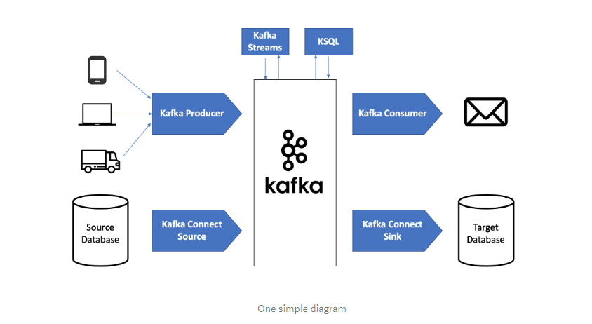
https://medium.com/@stephane.maarek/the-kafka-api-battle-producer-vs-consumer-vs-kafka-connect-vs-kafka-streams-vs-ksql-ef584274c1e

Slide 30
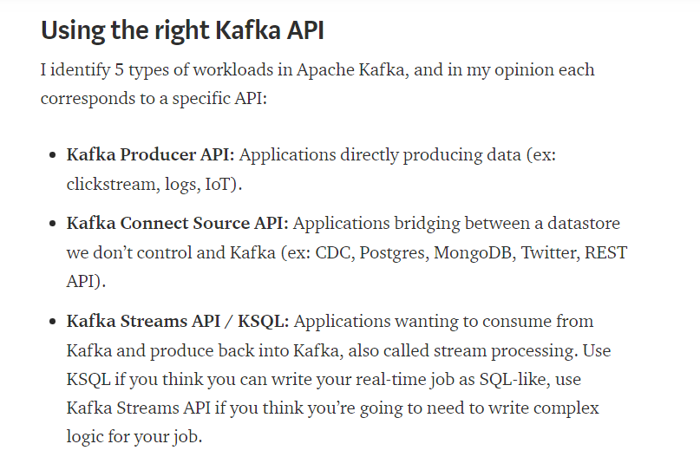

Slide 31
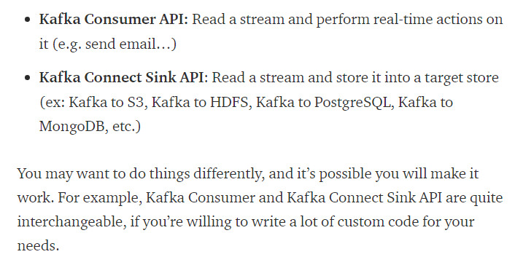

Slide 32
Kafka Producer API
Advantages
The Kafka Producer API is extremely simple to use: send data, it’s asynchronous and you will get a callback. This is perfectly suited for applications directly emitting streams of data such as logs, clickstreams, IoT.
It is very common to use this kind of API in combination with a Proxy
Limitations
The Kafka Producer API can be extended and built upon to do a lot more things, but this will require engineers to write a lot of added logic. The biggest mistake I see is people trying to perform ETL between a database and Kafka using the Producer API. Here are a few things that are not easy to do:
How to track the source offsets? (i.e. how to properly resume your producer if it was stopped)
How to distribute the load for your ETL across many producers?
For this, we’re much better off using the Kafka Connect Source API

Slide 33
Kafka Connect Source API
Advantages
The Kafka Connect Source API is a whole framework built on top of the Producer API. It was built so that developers would get a nicer API made for 1) producer tasks distribution for parallel processing, and 2) easy mechanism to resume your producers. The final goodie is a bustling variety of available connectors you can leverage today to onboard data from most of your sources, without writing a single line of code.
Limitations
If you do not get the chance to find an available source connector for a source of yours, reason being you’re using a very proprietary system in your environment, then you will have to write your own source connector. Writing your own source connector is actually very enjoyable, debugging it much less.

Slide 34
Kafka Consumer API
Advantages
The Kafka Consumer API is dead-simple, works using Consumer Groups so that your topics can be consumed in parallel. Although you need to be careful about a few things, such as offset management and commits, as well as rebalances and idempotence constraints, they’re really easy to write. For any stateless kind of workload, they will be perfect. Think notifications!
Limitations
When you perform some kind of ETL, Kafka Connect Sinks are better suited as they will avoid you to write some complicated logic against an external data source.
Kafka Connect Sink API
Advantages
. Kafka Connect Sink API is built on top of the consumer API, but does not look this different from it.
Limitations
If the data sink you’re writing to does not have an available connector (yet), you will have to write a Kafka Connect Sink (or consumer, if you prefer), and the debugging process might be a bit more complicated.

Slide 35
Kafka Streams API
Advantages
If you want to get into the stream processing world, meaning reading data from Kafka in real-time and after processing it, writing it back to Kafka, you would most likely pull your hair out if you used the Kafka Consumer API chained with the Kafka Producer API. Thankfully, the Kafka project now ships with Kafka Streams API (available for Java and Scala), which enables you to write either a High Level DSL (resembling to a functional programming / Apache Spark type of program), or the Low Level API (resembling more to Apache Storm). The Kafka Streams API does require you to code, but completely hides the complexity of maintaining producers and consumers, allowing you to focus on the logic of your stream processors. It also comes with joins, aggregations and exactly-once processing capabilities!
LIMITATIONS :-how complicated your topology will be, your Kafka cluster may have to start processing a lot more messages, although as an added benefit you will have “stateless” and fully resilient applications.

Slide 36
KSQL (streaming sql not batch on top of kafka streaming)
Advantages
KSQL is not directly part of the Kafka API, but a wrapper on top of Kafka Streams. It is still very worth mentioning here. While Kafka Streams allows you to write some complex topologies, it requires some substantial programming knowledge and can be harder to read, especially for newcomers. KSQL wants to abstract that complexity away by providing you with a SQL semantic (not ANSI) that is close to what you already know today. I have to admit it is extremely tempting to use and makes your stream processors a breeze to write. Remember this is not batch SQL but streaming SQL so a few caveats will appear.

Slide 37
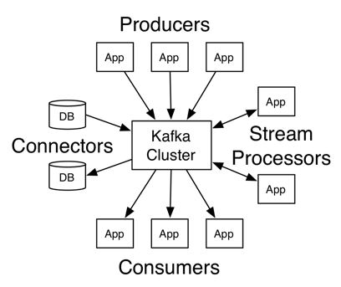
2. Kafka Architecture – Apache Kafka APIs
Apache Kafka Architecture has four core APIs, producer API, Consumer API, Streams API, and Connector API. Let’s discuss them one by one:
Q.9 What are main APIs of Kafka?
Ans. Apache Kafka has 4 main APIs:
Producer API
Consumer API
Streams API
Connector API
Q.18 Explain the role of the Kafka Producer API.
Ans. An API which permits an application to publish a stream of records to one or more Kafka topics is what we call Producer API.
Q.28 What is the role of Consumer API?
Ans. An API which permits an application to subscribe to one or more topics and also to process the stream of records produced to them is what we call Consumer API.
Q.29 Explain the role of Streams API?
Ans. An API which permits an application to act as a stream processor, and also consuming an input stream from one or more topics and producing an output stream to one or more output topics, moreover, transforming the input streams to output streams effectively, is what we call Streams API.
In other words Stream processors transform input streams to output streams.

Slide 38
Q.30 What is the role of Connector API?
Producers write to topics, and consumers read from topics. Connectors establish a link between Kafka topics and existing data systems.
Q.43 What do you mean by Stream Processing in Kafka?
Ans. The type of processing of data continuously, real-time, concurrently, and in a record-by-record fashion is what we call Kafka Stream processing.

Slide 39
Q.32 Compare: RabbitMQ vs Apache Kafka
Ans. One of the Apache Kafka’s alternative is RabbitMQ. So, let’s compare both: i. Features Apache Kafka– Kafka is distributed, durable and highly available, here the data is shared as well as replicated. RabbitMQ– There are no such features in RabbitMQ. ii. Performance rate Apache Kafka– To the tune of 100,000 messages/second. RabbitMQ- In case of RabbitMQ, the performance rate is around 20,000 messages/second.
Q.33 Compare: Traditional queuing systems vs Apache Kafka
Ans. Let’s compare Traditional queuing systems vs Apache Kafka feature-wise:
Messages Retaining
Traditional queuing systems– It deletes the messages just after processing completion typically from the end of the queue. Apache Kafka– But in Kafka, messages persist even after being processed. That implies messages in Kafka don’t get removed as consumers receive them.
Logic-based processing
Traditional queuing systems–Traditional queuing systems don’t permit to process logic based on similar messages or events. Apache Kafka– Kafka permits to process logic based on similar messages or events.

Slide 40
Q.37 Explain how to Tune Kafka for Optimal Performance.
Ans. So, ways to tune Apache Kafka it is to tune its several components:
Tuning Kafka Producers
Kafka Brokers Tuning
Tuning Kafka Consumers

Slide 41
Question Answer round
Q11) If the replica stays out of the ISR for a very long time, then what does it tell us?
If the replica stays out of the ISR for a very long time, or replica is not in synch with the ISR then it means that the follower server is not able to grasp data as fast the leader is doing. So basically the follower is not able to come up with the leader activities.
Q14) Within the producer can you explain when will you experience QueueFullException occur?
Well, if the producer is sending more messages to the broker and if it cannot handle this in the flow of the messages then we will experience QueueFullException.
The producers don't have any limitation so it doesn't know when to stop the overflow of the messages. So to overcome this problem one should add multiple brokers so that the flow of the messages can be handled perfectly and we won't fall into this exception again.

Slide 42
Q25) Explain the functionality of the Connector API in Kafka?
The Connector API is responsible where it allows the application to stay connected and keeping a track of all the changes that happen within the system. For this to happen, we will be using reusable producers and consumers which stays connected to the Kafka topics.
Q27) What is the purpose of the retention period in the Kafka cluster?
Within the Kafka cluster, it retains all the published records. It doesn’t check whether they have been consumed or not. Using a configuration setting for the retention period, the records can be discarded. The main reason to discard the records from the Kafka cluster is that it can free up some space.
Q28) Highlights of Kafka system?
It is dedicated to high performance
Low latency system
Scalable storage system
Q16) Explain the main difference between Kafka and Flume?
Both Kafka and Flume are used for real-time processing where Kafka seems to be more scalable and you can trust on the message durability.
3. Explain the role of the offset.
Messages contained in the partitions are assigned a unique ID number that is called the offset. The role of the offset is to uniquely identify every message within the partition.

Slide 43
Why do we need Kafka rather than other massaging system?
Support low latency message delivery.
Handling the real time traffic.
Assurance for fault tolerant.
Easy to integrate with Spark application to process a high volume of messaging data.
Has an ability to create a cluster of messaging container which monitor and supervise by coordination server like Zookeeper.
So, when we need to handle this kind of volume of data, we need Kafka to solve this problem.
https://www.knowledgehut.com/interview-questions/kafka

Slide 44
.What is the real-world use case of Kafka, which makes different from other messaging framework?
There is plethora of use case, where Kafka fit into the real work application, however I listed below are the real work use case which is frequently using.
Metrics: Use for monitoring operation data, which can use for analysis or doing statistical operation on gather the data from distributed system
Log Aggregation solution: can be used across an organization to collect logs from multiple services, which consume by consumer services to perform the analytical operation.
Stream Processing: Kafka’s strong durability is also very useful in the context of stream processing.
Asynchronous communication: In microservices, keeping this huge system synchronous is not desirable, because it can render the entire application unresponsive. Also, it can defeat the whole purpose of dividing into microservices in the first place. Hence, having Kafka at that time makes the whole data flow easier. Because it is distributed, highly fault-tolerant and it has constant monitoring of broker nodes through services like Zookeeper. So, it makes it efficient to work.
Chat bots: Chat bots is one of the popular use cases when we require reliable messaging services for a smooth delivery.
Multi-tenant solution. Multi-tenancy is enabled by configuring which topics can produce or consume data. There are also operations support for quotas
Above are the use case where predominately require a Kafka framework, apart from that there are other cases which depends upon the requirement and design.

Slide 45
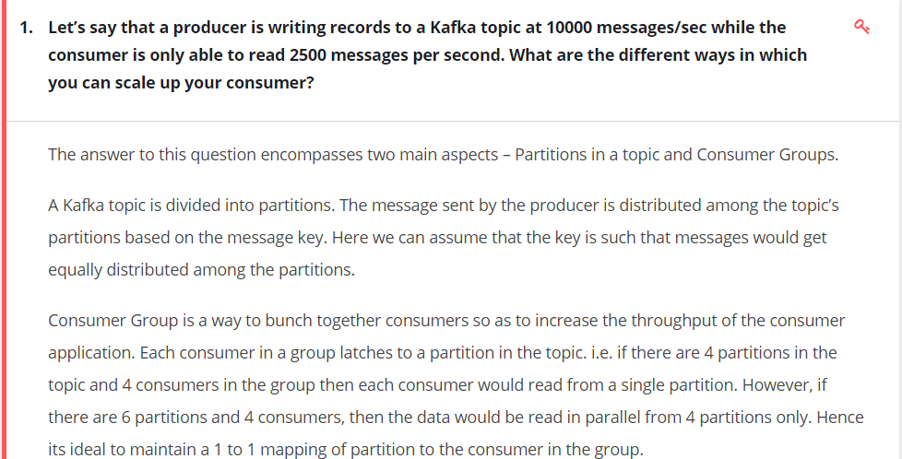
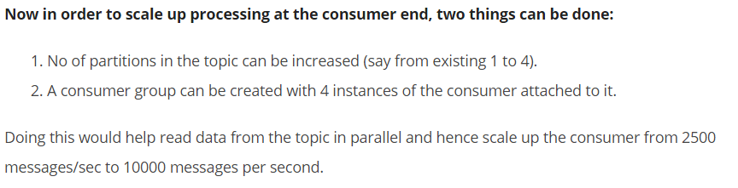

Slide 46
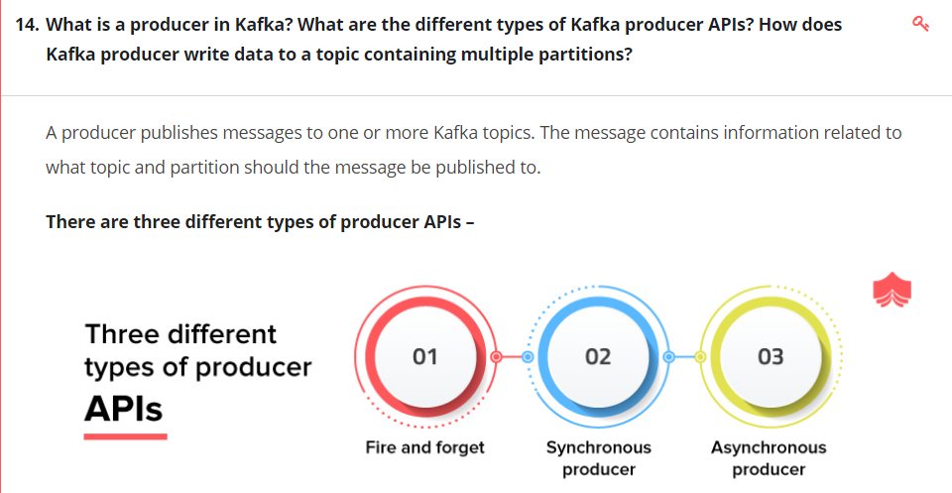

Slide 47
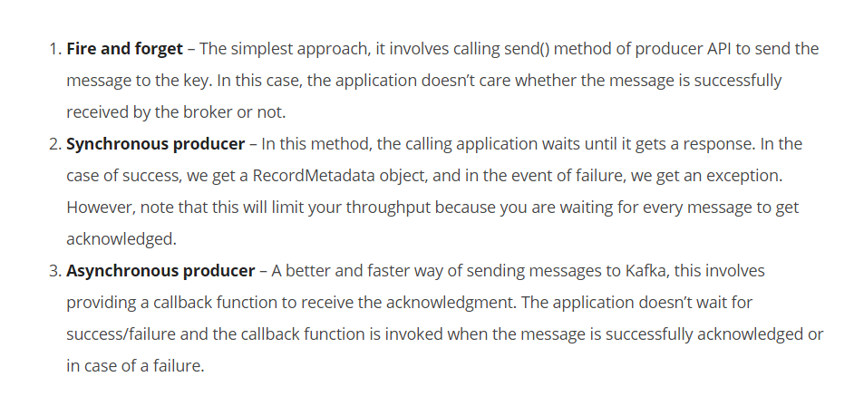
Kafka messages are key-value pairs. The key is used for partitioning messages being sent to the topic. When writing a message to a topic, the producer has an option to provide the message key. This key determines which partition of the topic the message goes to. If the key is not specified, then the messages are sent to partitions of the topic in round robin fashion.
Note that Kafka orders messages only inside a partition, hence choosing the right partition key is an important factor in application design.

Slide 48
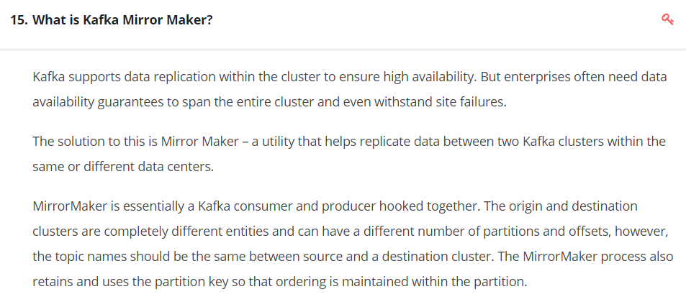

Slide 49
Adding some more doubts,please try to clear these too
Consider 3 nodes in a Kafka cluster and producer is trying to write data1,data2,data3??
q1)how it find the leader,on what basis Election will happen? q2)consider a scenerio ,data 1 is written in leader and replication didnt happend and in the middle of that leader got down, what happend to that data1,weather data loss will happen?? q3)before replication weather a consumer can consume the data from leader(not yet replicated the data)?how? q4)After sometime node 1 got up and it lost the leader position also then what will happen to the data written to that(not yet replicated),how it will replicate(replication will happen from leader to follower,here this node lost the leader position) q5)consider a kafka streaming writing to HDFs,assume what will happen if 1 hour HDFS is down? what will happen to the data which is incoming in these 1 hour?

Slide 50
q1)how it find the leader,on what basis Election will happen? Ans: Zookeeper does this part. You can find more details here https://www.tutorialspoint....
q2) If the leader goes down before acknowledgement, this means Producer have also not received the confirmation about the message being successfully stored. Though this will also depend on the API implementation and you can handle such a scenario during coding
q3) No, ideally this scenario will not happen. There are 2 ways of replication Async and Sync. During the Sync method Leader waits for majority of the followers to confirm if the data has been replicated. While on the Async method leader does not wait for any ack from followers and mark the process as complete, this is not fault tolerant. But once the data process by leader is completed it updates the offset id, and also flushes the data to the disk if configured batch size is full. After all this processing only data is available for consumers to pull.
q4) Assume here that node here will have to be brought up, which again gets registered with the zookeeper and start loading up all data. Earlier partially consumed data will be considered lost.
q5) In such a case you have a P1 issue to resolve :) Without the disks the data cannot be persisted, and all the disk writes will start throwing up exceptions and nodes will be down.

